Slide 1
18AIS101J-INTRODUCTION TO MATLAB FOR ARTIFICIAL INTELLIGENCE

Slide 2
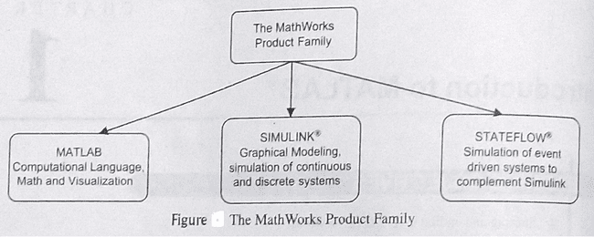

Slide 3
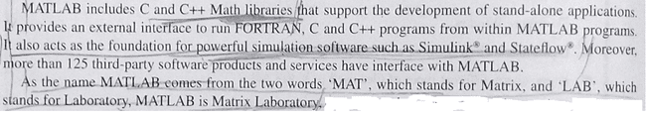

Slide 4
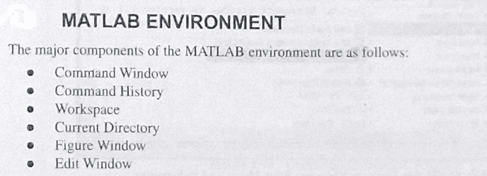

Slide 5

TYPES OF FILES

Slide 6
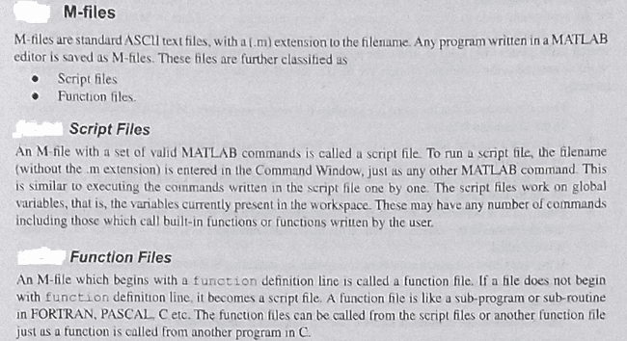

Slide 7
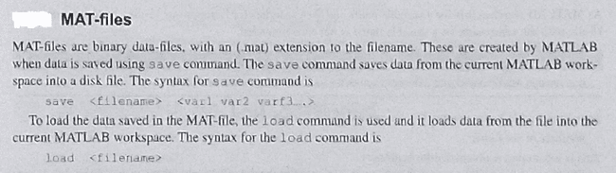

Slide 8
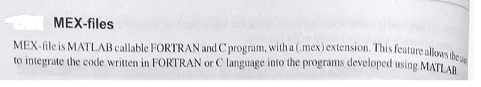

Slide 9
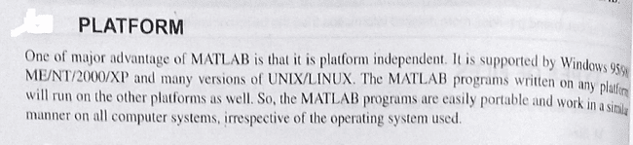

Slide 10
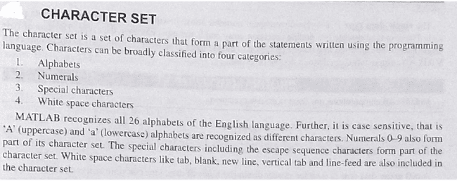
CONSTANTS ,VARIABLES AND EXPRESSIONS

Slide 11
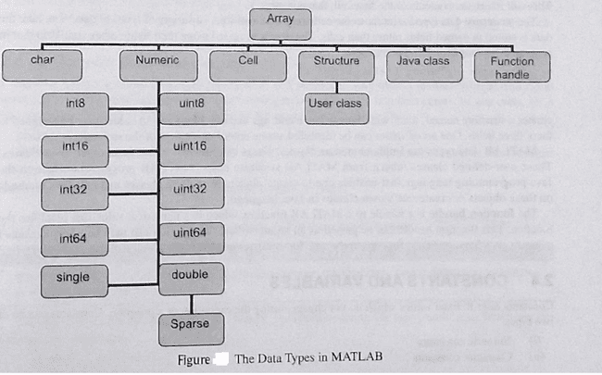
DATA TYPES

Slide 12
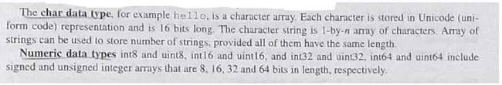

Slide 13
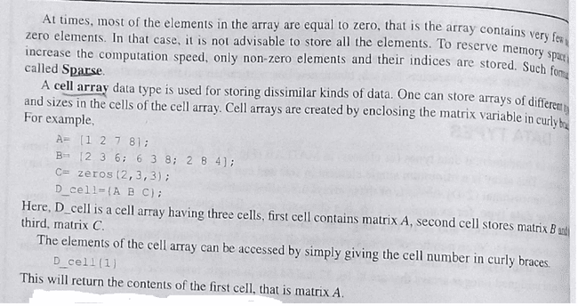

Slide 14
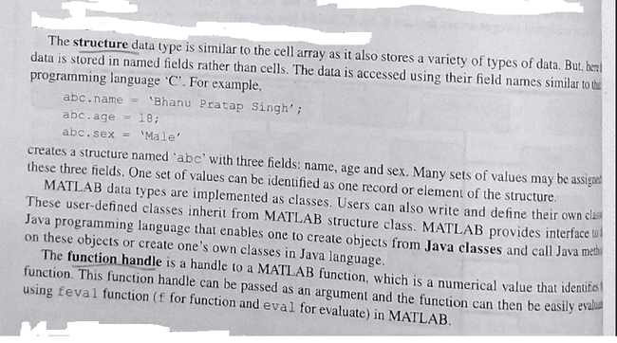

Slide 15
SCRIPTS
Scripts − script files are program files with .m extension.
Write the Command and execute it together.
Scripts do not accept inputs and do not return any outputs. They operate on data in the workspace.

Slide 16
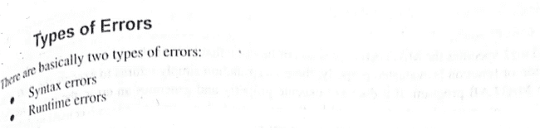

Slide 17
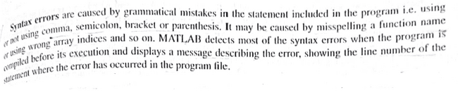

Slide 18
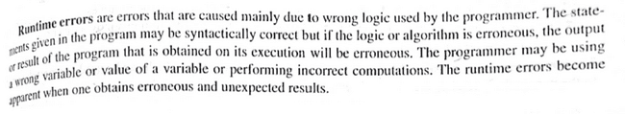

Slide 19
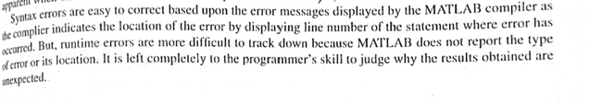

Slide 20
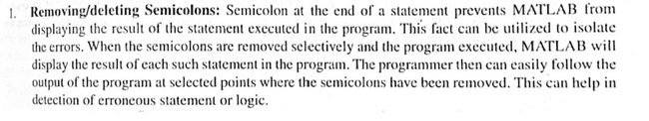

Slide 21
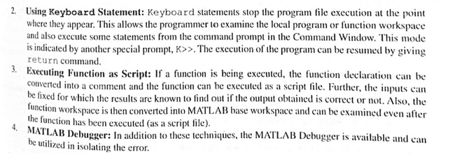

Slide 22
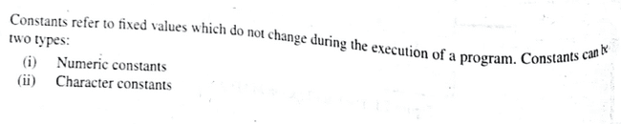
Constants and Variables

Slide 23
Numeric Constants
1.Integer Constants/Numbers.
2.Real Constants/Numbers.
3.Complex Constants/Numbers.

Slide 24
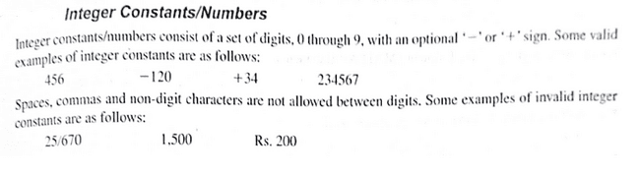
Integer Constants/Numbers.

Slide 25
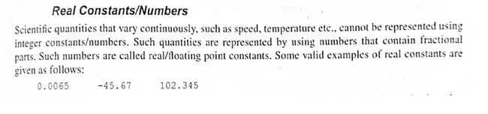
Real Constants/Numbers.

Slide 26
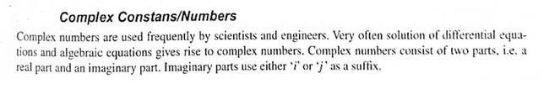
3.Complex Constants/Numbers.

Slide 27
Character Constants
1.Single Character Constants.
2.String Constants.
3.Escape Sequence Constants.

Slide 28
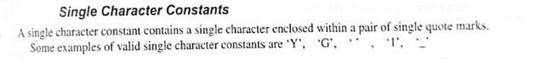
1.Single Character Constants.

Slide 29
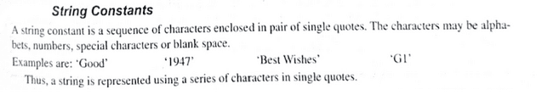
2.String Constants.

Slide 30
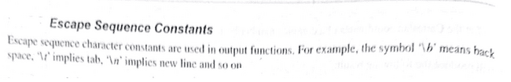
3.Escape Sequence Constants.

Slide 31
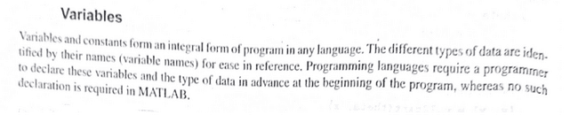
Variables

Slide 32
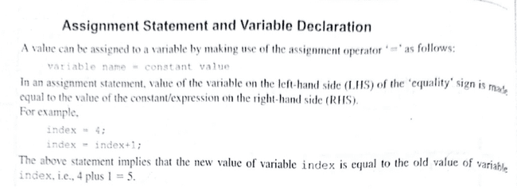

Slide 33
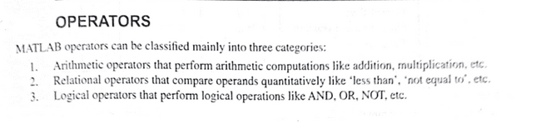

Slide 34
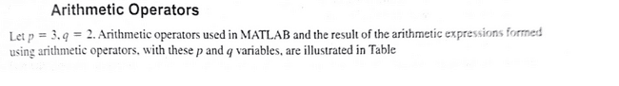
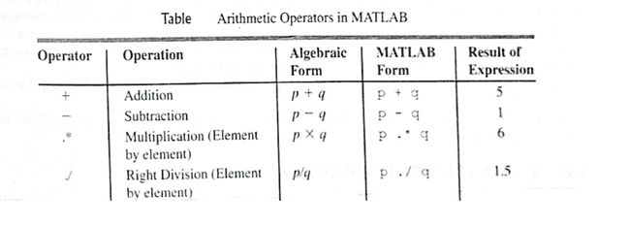

Slide 35
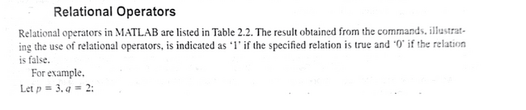
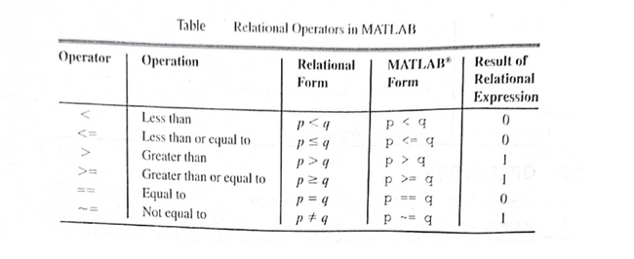

Slide 36
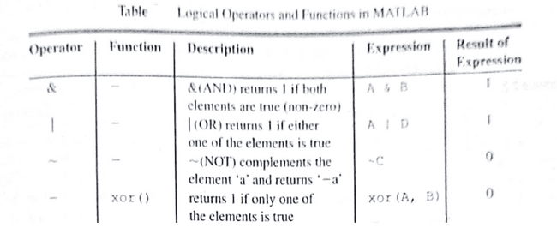
Logical Operators

Slide 37
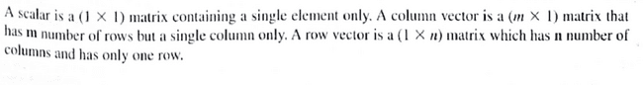
SCALARS AND VECTORS

Slide 38
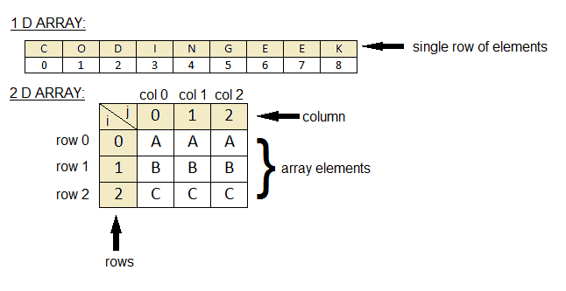
The main difference between 1D and 2D array is that the 1D array represents multiple data items as a list while 2D array represents multiple data items as a table consisting of rows and columns.

Slide 39
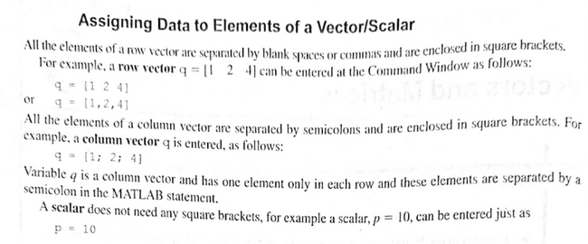

Slide 40
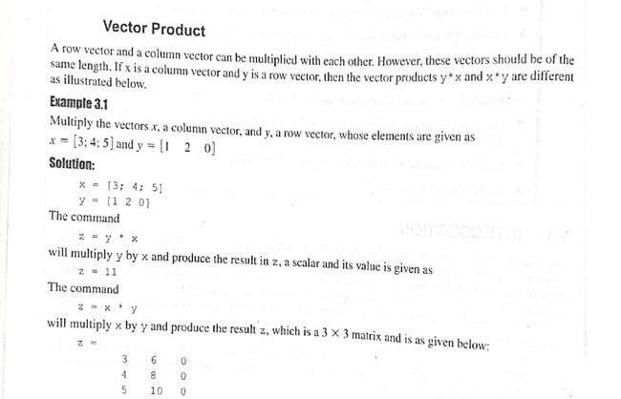

Slide 41
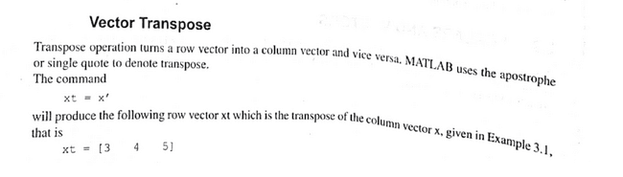
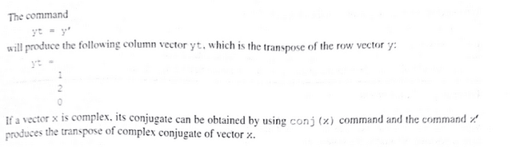

Slide 42
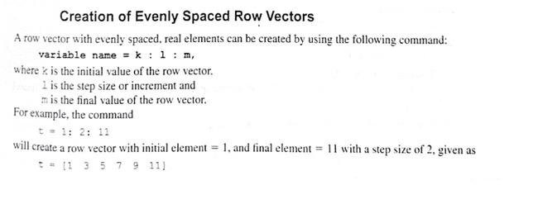

Slide 43
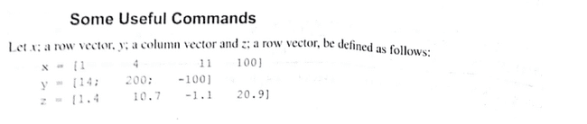
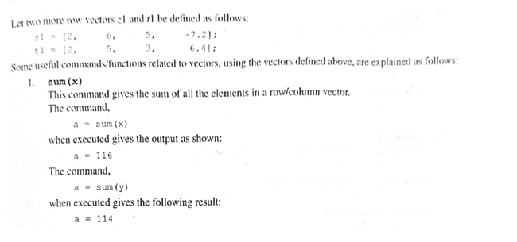

Slide 44
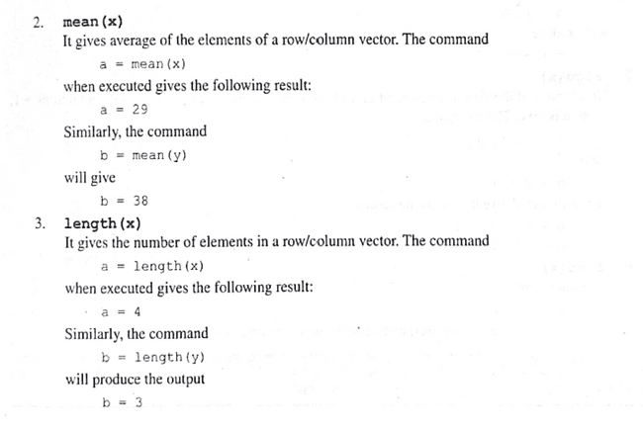

Slide 45
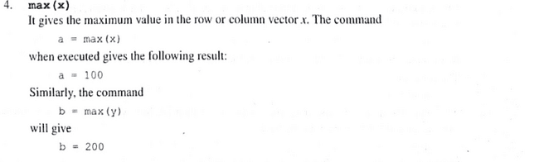
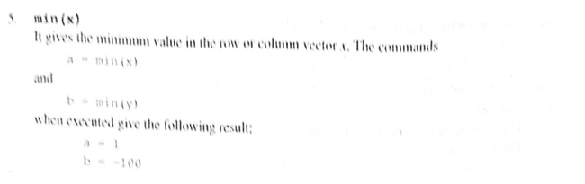

Slide 46
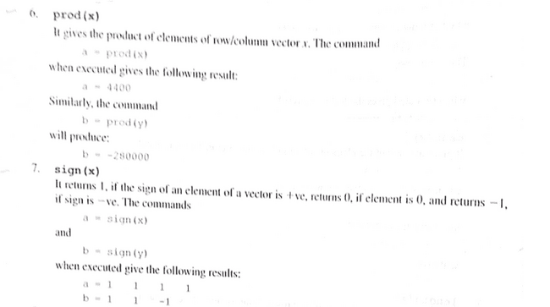
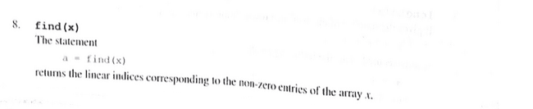

Slide 47
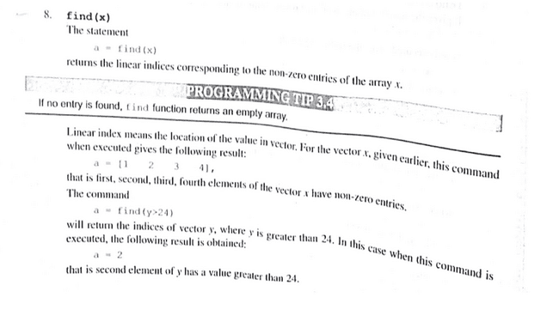

Slide 48
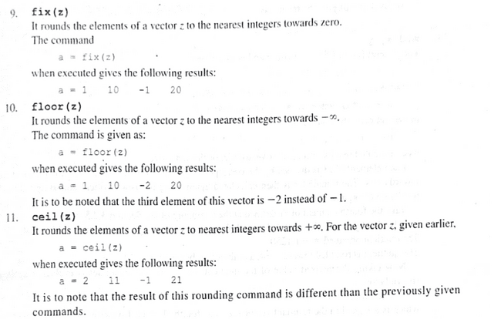

Slide 49
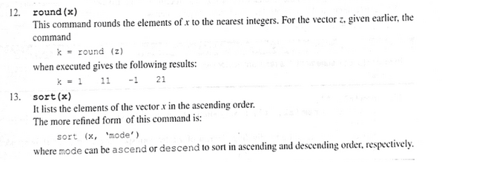

Slide 50


Slide 51


Slide 52


Slide 53
MATRIX MANIPULATIONS

Slide 54

The shape and size of a matrix can be altered by using the following MATLAB commands:

Slide 55


Slide 56


Slide 57


Slide 58


Slide 59


Slide 61



Slide 62


Slide 63


Slide 64


Slide 68


Slide 70


Slide 71


Slide 74


Slide 75


Slide 76


Slide 77


Slide 81


Slide 83

PLOTTING

Slide 84



Slide 85


Slide 86


Slide 87


Slide 88


Slide 89


Slide 90


Slide 91


Slide 92


Slide 93


Slide 94


Slide 95


Slide 96


Slide 97


Slide 98


Slide 99



Slide 100


Slide 101


Slide 102


Slide 103



Slide 104


Slide 105


Slide 106


Slide 107
MULTIPLE PLOTTING

Slide 108


Slide 109


Slide 112


Slide 114


Slide 115


Slide 117
STYLE OPTIONS

Slide 118


Slide 119


Slide 121


Slide 122
Legend Command

Slide 123


Slide 125


Slide 126
SUB PLOTS

Slide 129


Slide 131

SPECIALIZED TWO-DIMENSIONAL PLOTS

Slide 132


Slide 133


Slide 152


Slide 155


Slide 160


Slide 161


Slide 169
THREE DIMENSIONAL PLOTS

Slide 175


